Slide 1
Active Learning for Inference and Regeneration of Computer Programs that Store and Retrieve Data
Martin Rinard, Jiasi Shen, Varun Mangalick

Slide 2
Everyone is learning to program
Average number of CS majors per department
Source: Computing Research Association, CS Undergraduate Enrollments Surge Since 2006, https://cra.org/data/generation-cs/

Slide 3
Everyone is learning to program
Cumulative nonmajor enrollment (red) and major enrollment (blue) in computing courses
Source: Computing Research Association, CS Undergraduate Enrollments Surge Since 2006, https://cra.org/data/generation-cs/

Slide 4
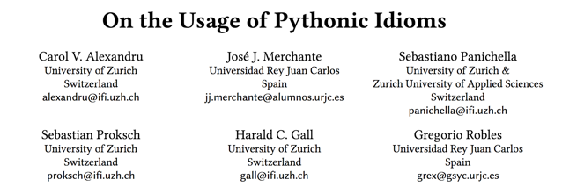
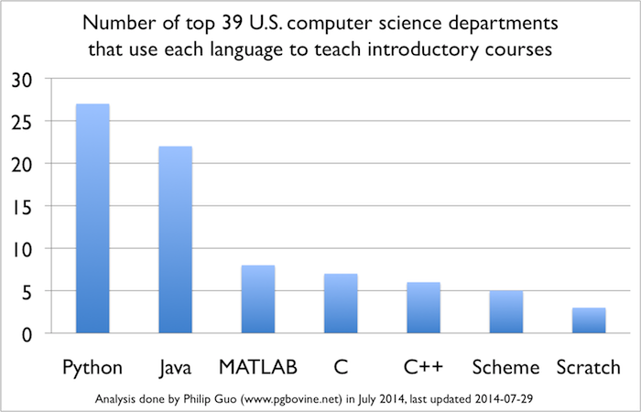
They are learning to write basic programs in simple programming languages
“
”

Slide 5
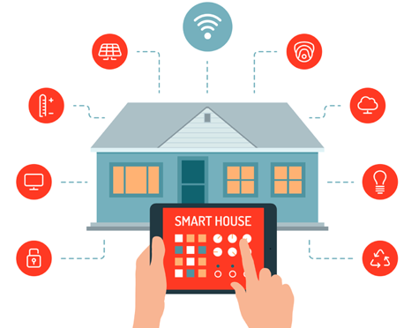
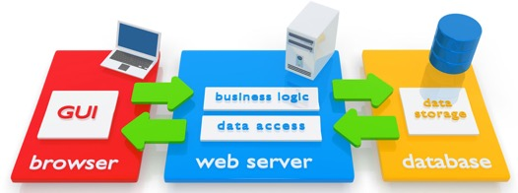
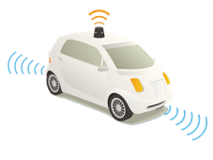
Complex computing environments
Source: http://www.justscience.in/articles/hardware-software-borderline-cloud-computing/2018/01/22
Source: https://www.bespokesoftwaredevelopment.com/blog/what-is-web-application-software/
Source:
http://drquincy.com/building-a-smart-home-tips-and-the-unique-concept/41/
Source:
https://jasondhall.com/self-driving-cars/

Slide 6
No clue about more complex platforms

Slide 7
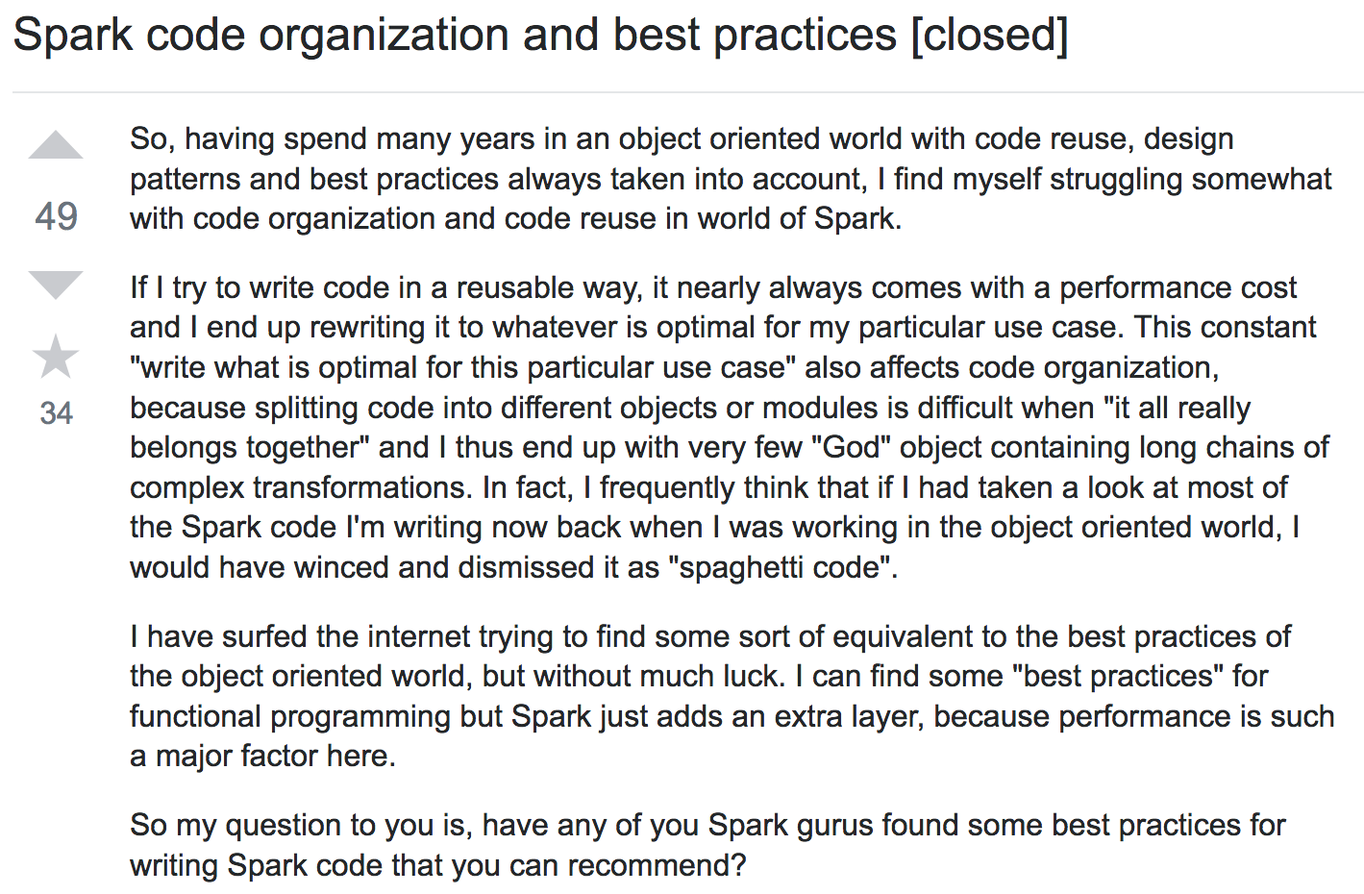
Even experience programmers

Slide 8
What we need
_____________
_____________________
___________
_________________
_____________
________
___________
_____
_______
_________
_____________
___________
______________________
What we have
_________________________
_________________________
Our system
_______
____
___________
______________________
_____________
________
___________
_____
_______
_____
__________
_____
__________
_______
____
___________
_______
____
___________
______________________
_____________
________
___________
_____
_______
_____________________
______________
_______
____
___________

Slide 9
Program inference and regeneration
Simple functionality
Works with complex platforms
?
Infer program
Representation of functionality
Regenerate program
_______
____
___________
______________________
_____________
________
___________
_____
_______
_____
__________
_____
__________

Slide 10
Black box inference with active learning
?
Choose inputs
Algorithm
Representation of functionality

Slide 11
Can’t possibly do this!
if x == 21734873:
A
else:
B

Slide 12
Degenerate solution
if input == i1:
print o1
else if input == i2:
print o2
else if input == i3:
...

Slide 13
What we need is a model of computation
Rules out uninferrable computations
Rules out degenerate solutions
Use domain-specific language to capture model of computation
Precisely structure the model of computation so it can be inferred
If the given program conforms to the DSL, guarantee correct inference

Slide 14
Model of computation in this talk: CRUD
Create – store data indexed by keys
Read – retrieve data by key
Update – update data by keys
Delete – delete data by keys
Basic Abstraction:
Program implements a collection of maps
Each map stores key-to-value mappings
Operations insert, retrieve, update, and delete mappings
Many programs implement this basic pattern

Slide 15
Example
Student Registration Application
Starting point:
Simple text-based implementation
Interface: store/retrieve operations
What we infer:
Number of maps
How operations store values into maps
How operations retrieve values from maps
How we do it: Active Learning
Store
Operations
?
?
Retrieve
Operations
?
?
?
?
enroll
?
?
?
id
?
rename
?
?
name
?
add
?
?
classes
?
?
Algorithm
drop
?
?
?
?
?
?
?
?

Slide 16
Maps initially empty
Inferred store/retrieve pairs
A
7
enroll
A
7
2018
id
A
enroll
x
y
z
id
x
7
y
Distinct
7
Algorithm

Slide 17
Maps initially empty
Inferred store/retrieve pairs
enroll
A
7
2018
enroll
x
y
z
id
x
y
id
7
Algorithm

Slide 18
Maps initially empty
Inferred store/retrieve pairs
enroll
A
7
2018
enroll
x
y
z
id
x
y
id
2018
Algorithm

Slide 19
Maps initially empty
Inferred store/retrieve pairs
enroll
A
7
2018
enroll
x
y
z
id
x
name
7
y
7
A
A
name
A
enroll
x
y
z
name
y
name
2018
A
x
Algorithm

Slide 20
Maps initially empty
Inferred store/retrieve pairs
enroll
A
7
2018
enroll
x
y
z
id
x
y
classes
A
7
classes
A
2018
enroll
x
y
z
name
y
classes
7
A
x
classes
7
2018
classes
2018
A
classes
2018
7
Algorithm

Slide 21
Maps initially empty
Inferred store/retrieve pairs
enroll
x
y
z
id
x
rename
7
A
name
7
y
A
enroll
x
y
z
name
y
A
x
7
A
rename
y
x
name
y
x
Algorithm

Slide 22
Maps initially empty
Inferred store/retrieve pairs
enroll
x
y
z
id
x
y
add
7
cs101
classes
7
2018
cs101
enroll
x
y
z
name
y
cs101
x
rename
y
x
name
y
x
Algorithm
add
y
c
classes
y
w
7
cs101
c

Slide 23
Inferred store/retrieve pairs
A
7
enroll
A
7
2018
id
A
enroll
x
y
z
id
x
y
rename
7
A
name
7
7
A
add
7
cs101
classes
7
2018
enroll
x
y
z
name
y
x
drop
7
cs101
7
A
rename
y
x
name
y
x
add
y
c
classes
y
w
c
7
cs101

Slide 24
Inferred store/retrieve pairs
enroll
A
7
2018
enroll
x
y
z
id
x
y
name
7
7
A
A
enroll
x
y
z
name
y
x
rename
y
x
name
y
x
add
y
c
classes
y
w
c

Slide 25
Inferred store/retrieve pairs
enroll
x
y
z
id
x
y
rename
7
A
name
7
A
enroll
x
y
z
name
y
x
7
A
rename
y
x
name
y
x
add
y
c
classes
y
w
c

Slide 26
Inferred store/retrieve pairs
Maps initially empty
enroll
A
7
2018
enroll
x
y
z
id
x
y
rename
7
A
name
7
enroll
x
y
z
name
y
x
A
rename
y
x
name
y
x
add
y
c
classes
y
w
c

Slide 27
Inferred store/retrieve pairs
Maps initially empty
enroll
x
y
z
id
x
y
rename
7
A
name
7
A
enroll
x
y
z
name
y
x
7
A
rename
y
x
name
y
x
add
y
c
classes
y
w
c

Slide 28
Inferred store/retrieve pairs
Maps initially empty
enroll
x
y
z
id
x
y
add
7
cs101
classes
7
2018
enroll
x
y
z
name
y
cs101
x
rename
y
x
name
y
x
add
y
c
classes
y
w
c
7
cs101

Slide 29
Inferred store/retrieve pairs
Maps initially empty
enroll
x
y
z
id
x
y
rename
7
A
name
7
add
7
A
enroll
x
y
z
name
y
x
A
rename
y
x
name
y
x
add
y
c
classes
y
w
c

Slide 30
Inferred store/retrieve pairs
enroll
x
y
z
id
x
y
enroll
x
y
z
name
y
x
rename
y
x
name
y
x
add
y
c
classes
y
w
c

Slide 31
Inferred program in DSL
Maps NameToId, IdToName, IdToClasses
Store enroll x y z => NameToId[x] = y, IdToName[y] = x
Store rename x y => IdToName[x] = y
Store add x y => IdToClasses[x] = y
Retrieve id x => return NameToId[x]
Retrieve name x => return IdToName[x]
Retrieve classes x => return IdToClasses[x]

Slide 32
Inferred program in DSL
Maps NameToId, IdToName, IdToClasses
Store enroll x y z => NameToId[x] = y, IdToName[y] = x
Store rename x y => IdToName[x] = y
Store add x y => IdToClasses[x] = y
Retrieve id x => return NameToId[x]
Retrieve name x => return IdToName[x]
Retrieve classes x => return IdToClasses[x]

Slide 33
Inferred program in DSL
Maps NameToId, IdToName, IdToClasses
Store enroll x y z => NameToId[x] = y, IdToName[y] = x
Store rename x y => IdToName[x] = y
Store add x y => IdToClasses[x] = y
Retrieve id x => return NameToId[x]
Retrieve name x => return IdToName[x]
Retrieve classes x => return IdToClasses[x]

Slide 34
Inferred program in DSL
Maps NameToId, IdToName, IdToClasses
Store enroll x y z => NameToId[x] = y, IdToName[y] = x
Store rename x y => IdToName[x] = y
Store add x y => IdToClasses[x] = y
Retrieve id x => return NameToId[x]
Retrieve name x => return IdToName[x]
Retrieve classes x => return IdToClasses[x]

Slide 35
Inferred program in DSL
Seed program
Maps NameToId, IdToName, IdToClasses
Store enroll x y z => NameToId[x] = y, IdToName[y] = x
Store rename x y => IdToName[x] = y
Store add x y => IdToClasses[x] = y
Retrieve id x => return NameToId[x]
Retrieve name x => return IdToName[x]
Retrieve classes x => return IdToClasses[x]
_______
____
___________
______________________
_____________
________
___________
_____
_______
_____
__________
_____
__________
Existing program
?
_______
____
___________
______________________
_____________
________
___________
_____
_______
_______
____
___________
_______________________
_____
_______
_____
__________
_____
__________

Slide 36
Correctness if the original program conforms to our model of computation
If original program is expressible in our DSL:
Algorithm finds unique program
Algorithm ends in finite time (by enumerating pairs of operations)
Takeaway: Design the DSL and inference algorithm together

Slide 37
What we do not (and don’t want to) know
Irrelevant implementation detail:
Internal structure of original program
Packages/libraries original program uses
Language in which the original program is implemented

Slide 38
Generalizations
Maps NameToId, IdToName, IdToClasses
Store enroll x y z => NameToId[x] = y, IdToName[y] = x
Store rename x y => IdToName[x] = y
Store add x y => IdToClasses[x] = y
Retrieve id x => return NameToId[x]
Retrieve name x => return IdToName[x]
Retrieve classes x => return IdToClasses[x]

Slide 39
Generalizations: Accumulate lists
Maps NameToId, IdToName, IdToClasses
Store enroll x y z => NameToId[x] = y, IdToName[y] = x
Store rename x y => IdToName[x] = y
Store add x y => IdToClasses[x] = IdToClasses[x] + y
Retrieve id x => return NameToId[x]
Retrieve name x => return IdToName[x]
Retrieve classes x => return IdToClasses[x]

Slide 40
Generalizations: Remove elements
Maps NameToId, IdToName, IdToClasses
Store enroll x y z => NameToId[x] = y, IdToName[y] = x
Store rename x y => IdToName[x] = y
Store add x y => IdToClasses[x] = IdToClasses[x] + y
Store drop x y => IdToClasses[x] = IdToClasses[x] - y
Retrieve id x => return NameToId[x]
Retrieve name x => return IdToName[x]
Retrieve classes x => return IdToClasses[x]

Slide 41
Generalizations: Retrieve only when inputs satisfy some condition
Maps NameToId, IdToName, IdToClasses, IdToYear
Store enroll x y z => NameToId[x] = y, IdToName[y] = x, IdToYear[y] = z
Store rename x y => IdToName[x] = y
Store add x y => IdToClasses[x] = IdToClasses[x] + y
Store drop x y => IdToClasses[x] = IdToClasses[x] - y
Retrieve id x => return NameToId[x]
Retrieve name x => return IdToName[x]
Retrieve classes x => return IdToClasses[x]
Retrieve nameByYear x y => return IdToName[y] if IdToYear[x] >= y

Slide 42
Potential regenerations
Encapsulated expert knowledge - Implement once
Automatically generated safety/security checks
Automatically generated code for data storage
Databases, fault tolerant replications, other data structure implementations
Automatically generated user interfaces
GUI, web apps, mobile apps
Automatically generated configuration files
Database table schema, library versions, etc.

Slide 43
Inference and Regeneration
?
_______
____
___________
______________________
_____________
________
___________
_____
_______
_______
____
___________
_______________________
_____
_______
_____
__________
_____
__________

Slide 44
Future
Broader range of applications
Legacy programs, obfuscated programs
More sophisticated inference algorithms
More features – conditionals, loops, more sophisticated state
Black box, gray box, white box

Slide 45
Black box inference
?
Choose inputs
Algorithm
Representation of functionality

Slide 46
Gray box inference: Exploiting component decompositions
?
Choose inputs
Algorithm
Representation of functionality
?
?

Slide 47
Gray box inference (Konure): Exploiting component decompositions
?
Choose inputs
Algorithm
Representation of functionality
DB

Slide 48
Conclusion
What we need
_____________
_____________________
___________
_________________
_____________
________
___________
_____
_______
_________
_____________
___________
______________________
What we have
_________________________
_________________________
Inference and Regeneration
_______
____
___________
______________________
_____________
________
___________
_____
_______
_____
__________
_____
__________
_______
____
___________
_______
____
___________
______________________
_____________
________
___________
_____
_______
_____________________
______________
?
_______
____
___________
_______
____
___________
_______________________
_____
_______
_____
__________

